Slide 1
Vector Algebra

Slide 2
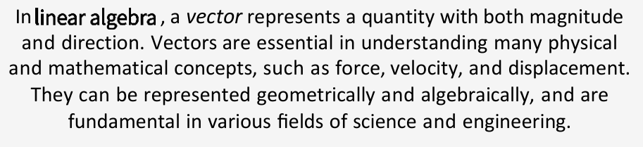
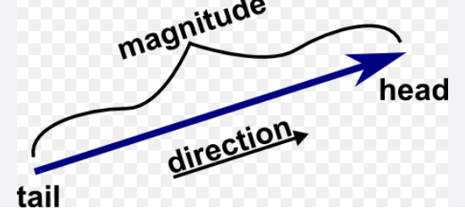
What is Vector

Slide 3
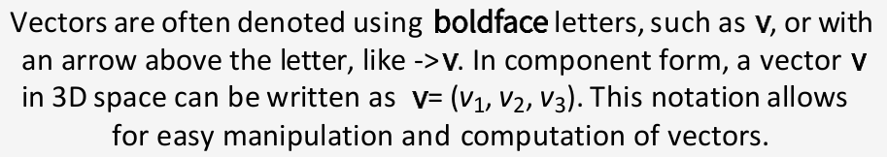
Vector Notation

Slide 4
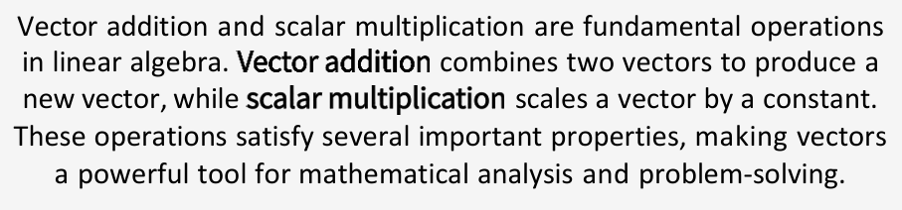
Vector Operations

Slide 5
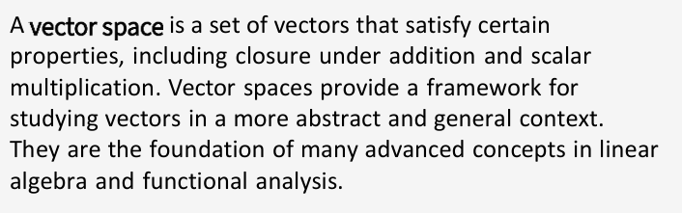
Vector Spaces

Slide 6
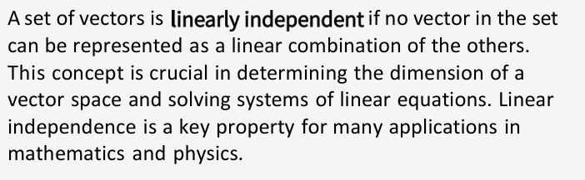
Linear Independence

Slide 7
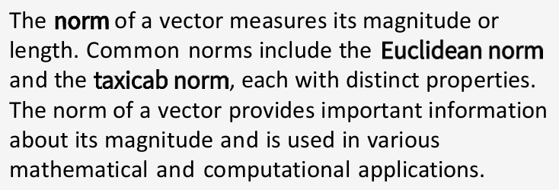
Vector Norm and Magnitude

Slide 8
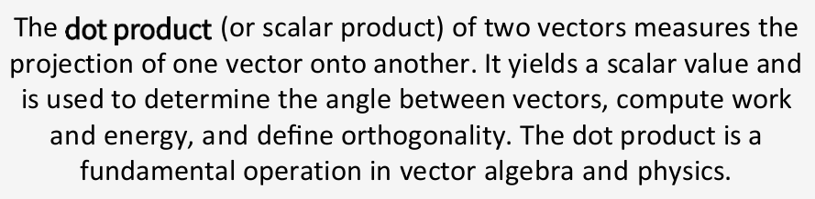
Dot Product

Slide 9
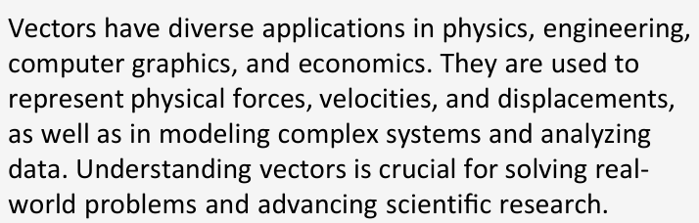
Applications

Slide 10
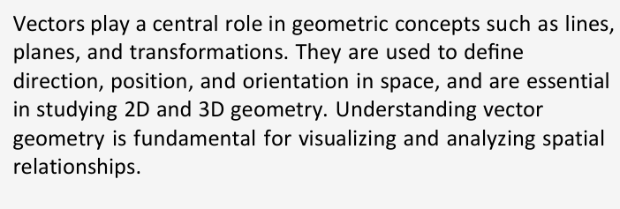
Vector Geometry

Slide 11
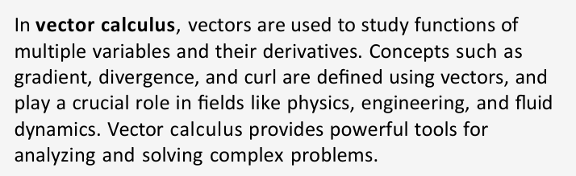
Vector Calculus

Slide 12
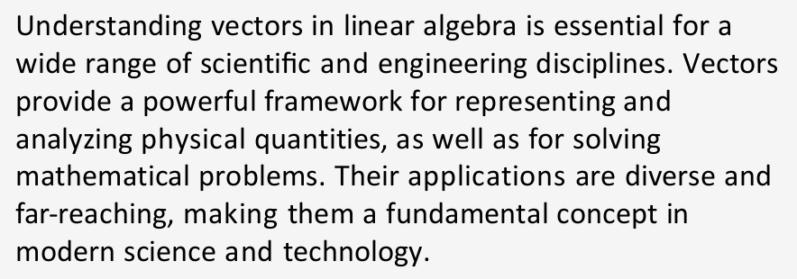
Conclusion

Slide 13
Vector is nothing but our data points , as number of features increases we can represent data points as a vector and then using some properties of vector, we can apply to feature as well. It help us to understand the relation between the feature
This is the most basic perspective of vector.
Vector can be use in NLP. Like we can not put word directly to model so we are converting word into vector and then vector use in model. This is the biggest advantage of vector
Vectorisation techniques is nothing but way to embed or encoded the data / text and then you can play around the vectors as same as playing around words
just the diff is machine would understand.
Clustering is the another example

Slide 14
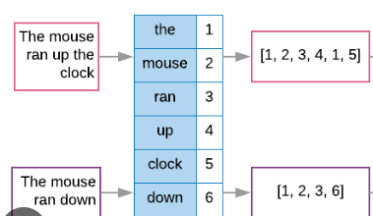
Vectorization
The process of converting data, like text or images, into numerical vectors (arrays of numbers) that algorithms can understand and process, enabling mathematical operations and analysis.
Model trained on vector.
Like,

Slide 15
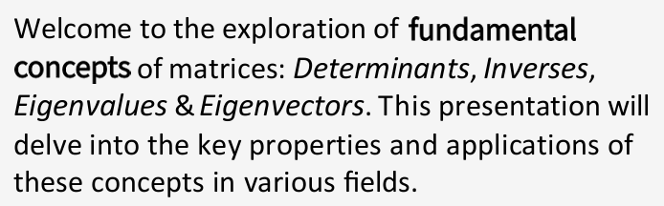
Matrices Eigen Values & Eigen Vectors

Slide 16
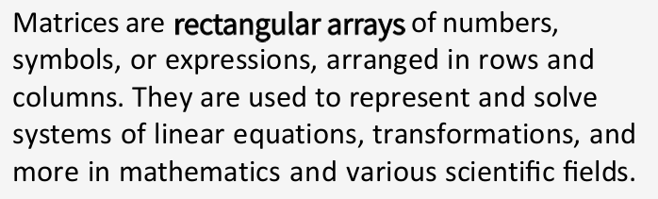
What are Matrices ?
All the images are coming from matrices
2-D and 3-D matrices we have
Matrices using in Instagram Filter, also images are represented through matrices

Slide 17
Matrices Application
We used different function from Numpy and Pandas library for multiplication, division of matrices or constant value to the matrices
Matrices use in normalization, when we convert linear equation to a matrix and you can find the value of co efficient. We can not use directly, but we have application for smaller machine learning model.
None of linear equation have direct relation ship to the model, if they have then they have polynomial relationship

Slide 18
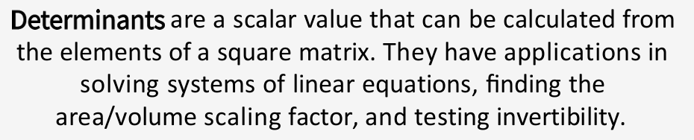
Determinants
If you are multiplying m*n and n*q matrix then multiplication of two matrix will be m*q matrix.

Slide 19
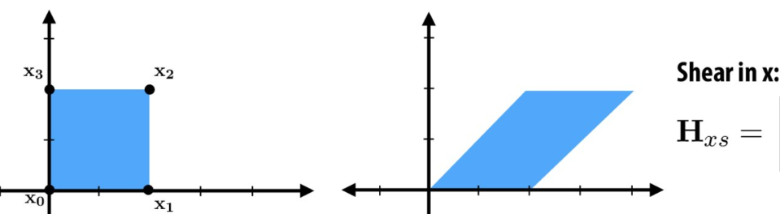
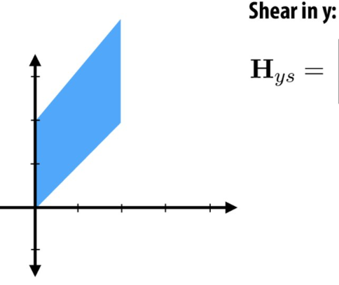
Transformation of vectors
You are multiplying base vector and matrix and new matrix will become a new transformation of matrix
If you are multiplying m*n and n*q matrix then multiplication of two matrix will be m*q matrix.
Shear transformation is show below
In linear transformation, only magnitude will change not direction. And rotation transformation will change the direction.

Slide 20
Core application of matrices is transformation -> function will take a input as a vector -> give output as a vector
Some time vector called single column matrix
Assume you are taking one vector and doing some transformation and making another vector
To do that conversion, we are taking matrices, we are multiplying vector with matrix.
Till this time vector called base vector space (I,j), now I am making the transformation according to matrix. After multiplying new vector will create
Once I done this transformation, factor by which the area that reshaped or space is reshaped. The factor determined by the determinants of the matrix.

Slide 21
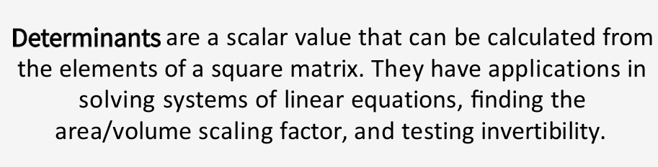
Determinants

Slide 22
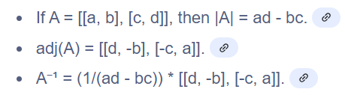
Inverse of Matrix
If determinant is 0 then inverse of matrix will not possible.

Slide 23
When we have more features, complexity of my model increase.
In NLP example all the words are feature and 1 or 0 are value for the same
In NLP example in 2 sentence 7 features we have
So how many features we have in paragraph or essay or book or complete LLM (Large Language Model)
So we have more complexity in features and so we have lot of columns are there means we have many dimensions are there.
The problem we are trying to solve here is dimensionality reduction
Ex I can convert 4000 dimension to 100 dimension

Slide 24
Eigen Value or Eigen Vector
An eigenvector v of a square matrix A is a non-zero vector such that when multiplied by A, the result is a scalar multiple of the original vector, i.e., Av = λv, where λ is a scalar called the eigenvalue.
Eigenvectors are special because they maintain their direction (or direction is reversed) when transformed by the matrix, only changing in magnitude (or being flipped).
When the transformation on vector v is done with matrix A, we will see transformation only in magnitude not in case of direction
Means that matrix does not change much on my vector.
This type of vector are called Eigen Vector and λ value is Eigen value
Once we got eignevalue and eigenvector, we can use these vector as your column value. And replace your matrix by eigen vector
in Machine Learning, eigenvectors and eigenvalues, particularly through Principal Component Analysis (PCA), are used for dimensionality reduction by identifying the principal directions of variance in data, allowing for efficient data representation and analysis.

Slide 25
Example, If I have rubber shit and Matrix line on that. If I stretch rubber sheet in some direction, stretching is matrix transformation.
So for each matrix transformation, you will observe a point on rubber shit that is not changing. That’s why we are drawing grids on it.
Their would be one grid or one point on sheet that will not move or change that particular point or that particular vector on sheet would be eigen vector
This eigenvector giving an idea what ever transformation will happen the variance is the same.
Like we have 2 * 2 matrix and transforming with eigen vector which is 2*1 and getting a new vector which is 2 * 1
So at start we have 2 dimension which we reduced to 1 dimension while holding the maximum variance
Same idea will happen while reducing the dimension
Example I will make the matrix of 4000 and will try to find out eigen vector and do the transformation with Eigen vector and that will give me first principle component
This method is called Principle Component Analysis (PCA)

Slide 26
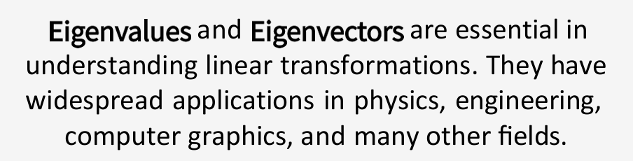
Principal Component Analysis (PCA) is a statistical technique used to reduce the dimensionality of datasets by identifying and retaining the most important features, known as principal components, while minimizing information loss.
This is very important topic for interview perspective

Slide 27
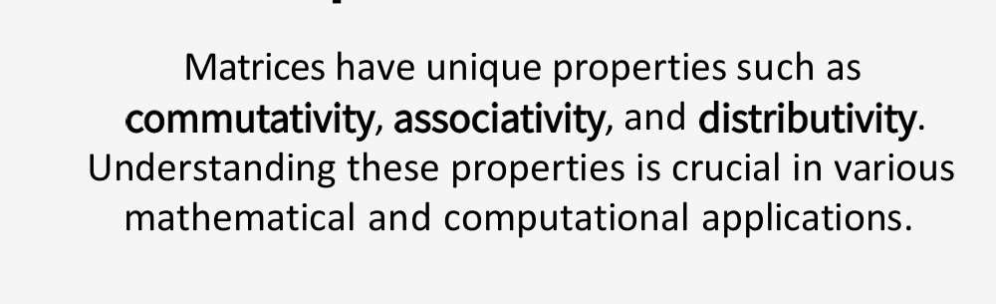
Properties of Matrices

Slide 28
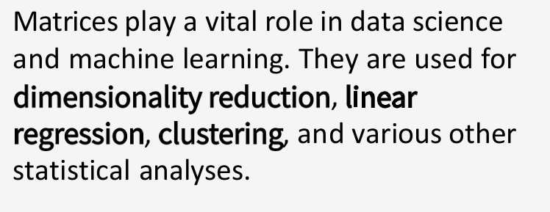
Applications

Slide 29
Challenge and Limitations

Slide 30
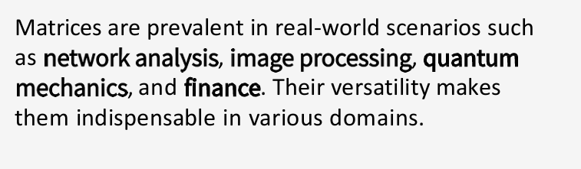
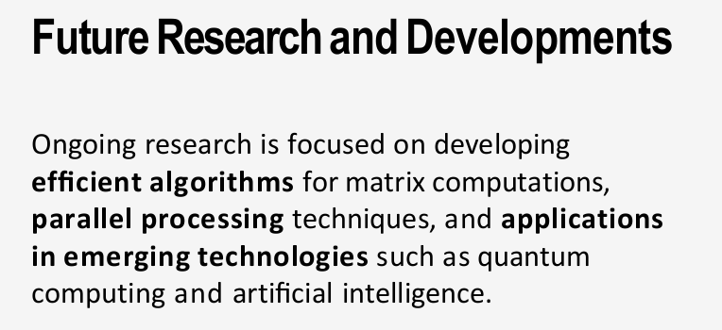
Real World Example

Slide 31
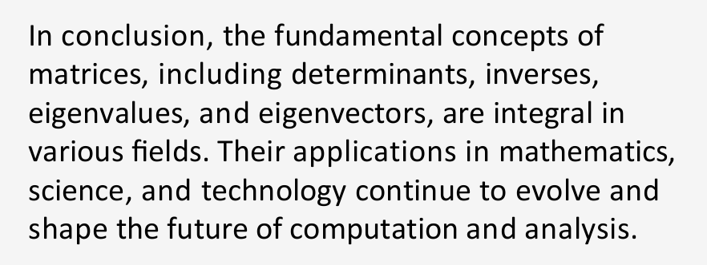
Conclusion

